Slide 1
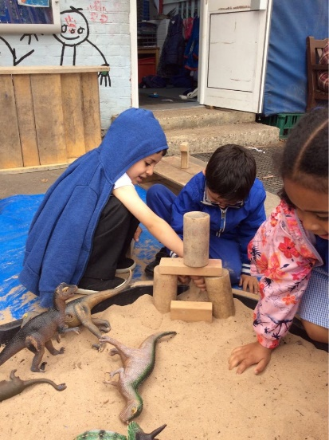
Welcome to Wessex Gardens
What to expect in Reception

Slide 2
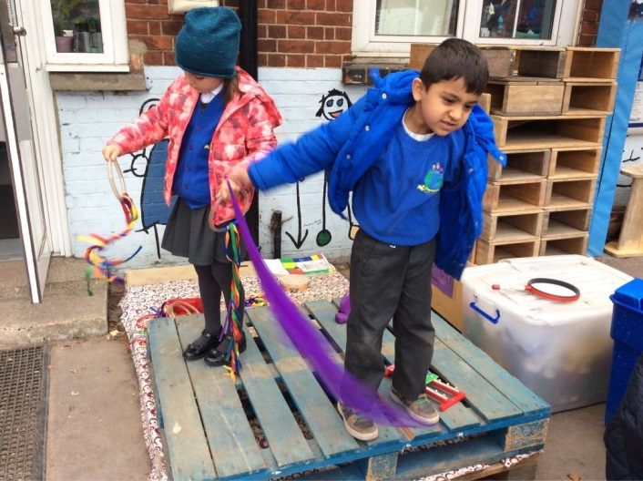
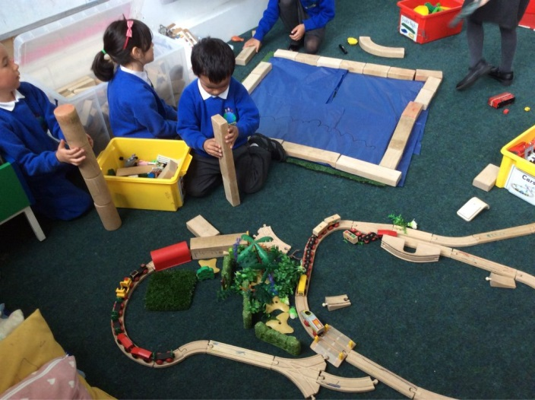
Today you will have a chance to:
Find out lots of information about the new year ahead.
Have an opportunity to meet the team.
Find out how the Reception routine works.

Slide 3
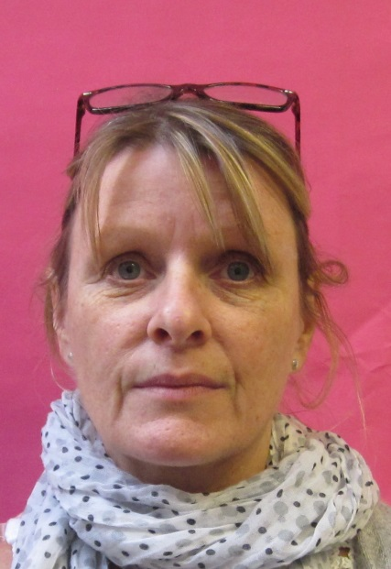
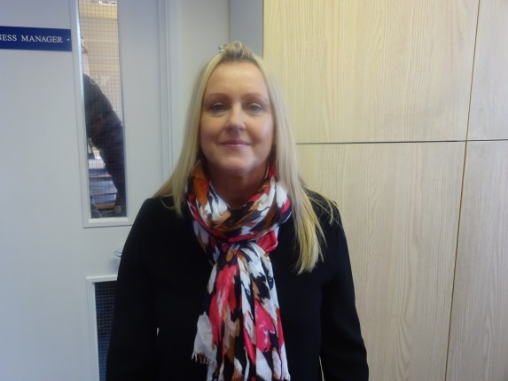
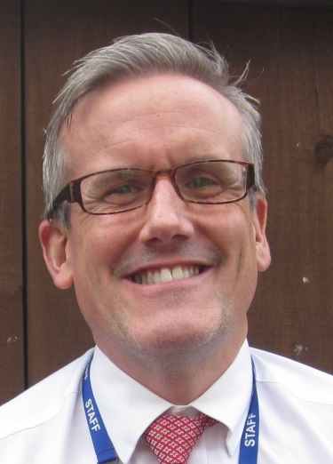
Who we are!
The School has many members of staff available to help you.
We are:
Senior Leaders
Office staff
SENco

Slide 4
Our Reception
We are called Silver Birch.
We aim for the children to be confident and happy in developing relationships with all the Silver Birch team.

Slide 5
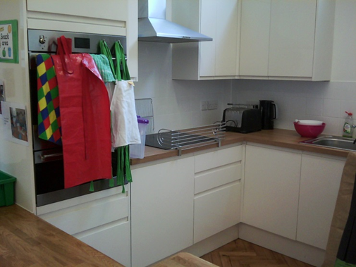
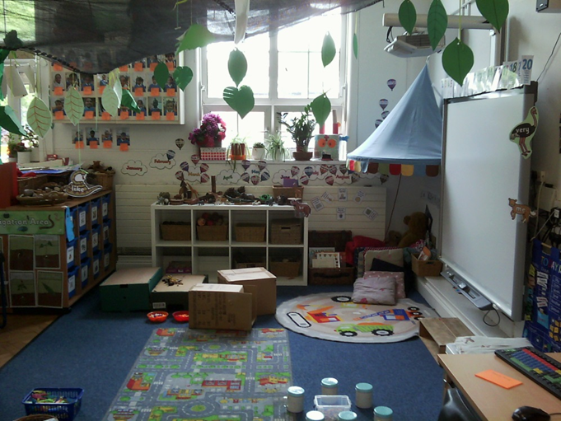
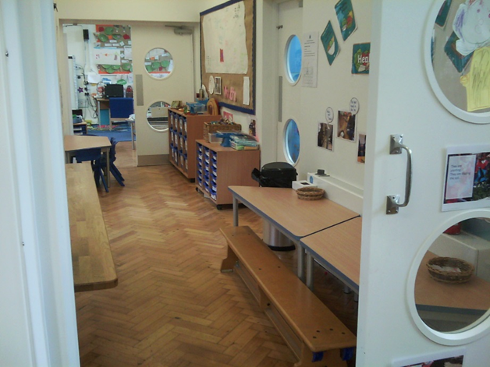
Silver Birch
We are very lucky to have a lovely unit for Reception.
We have our inside learning areas, including a small room for reading and small group activities and the outdoor learning space, which we share with Nursery.
We also have access to the larger playground to play games like hockey and tennis.
We have a kitchen for cooking activities.

Slide 6
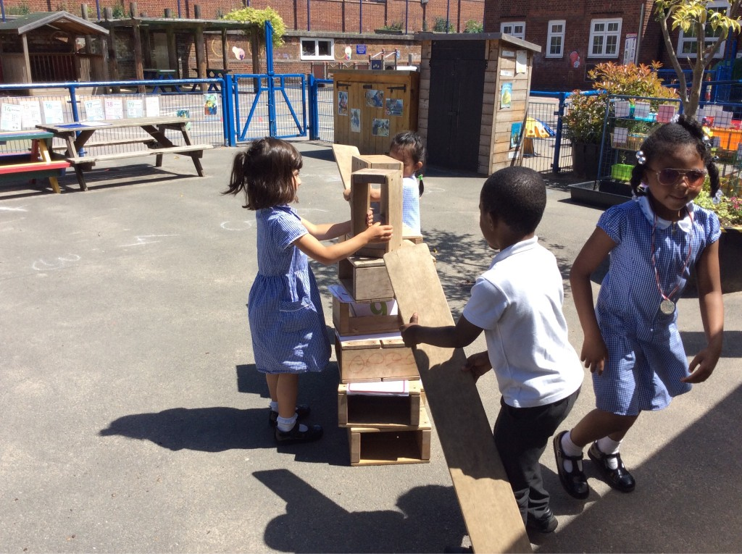
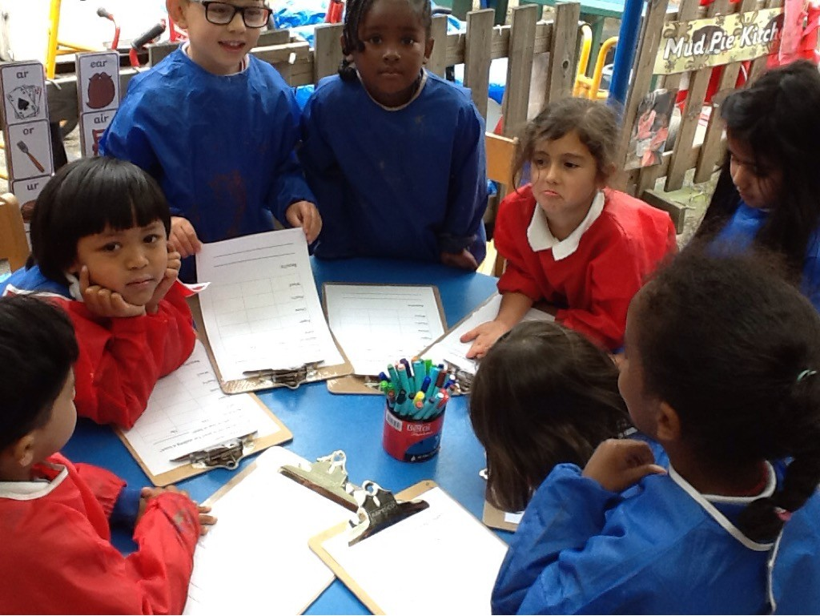
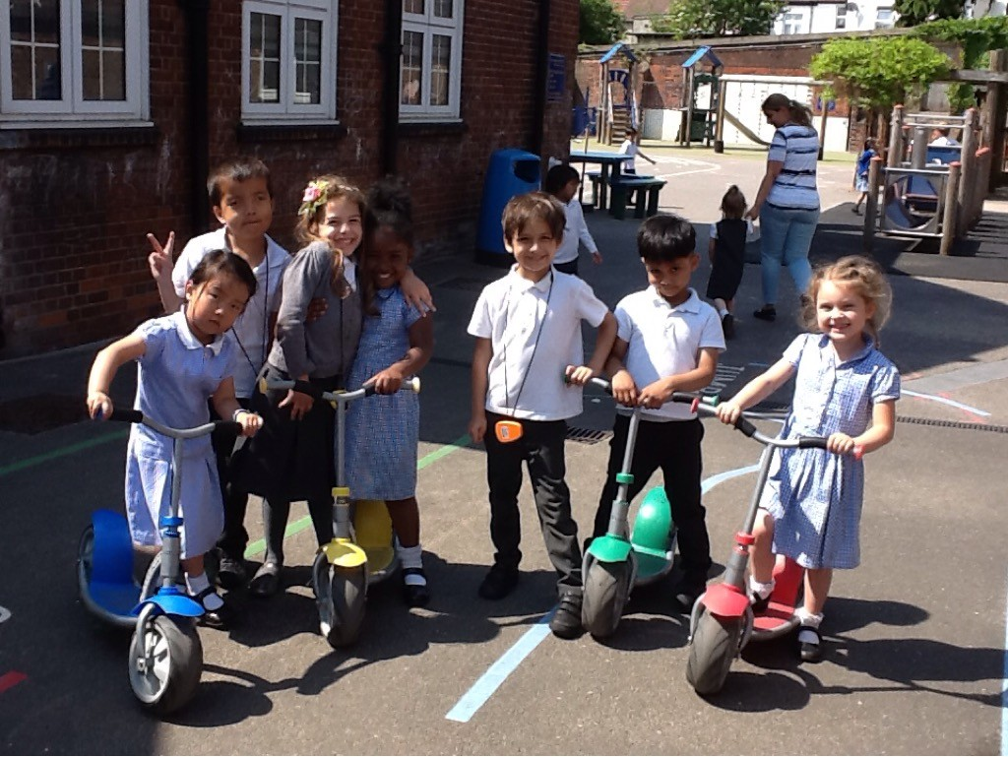

Slide 7
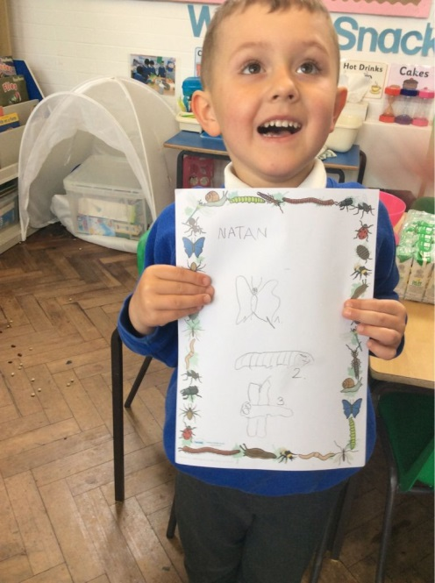
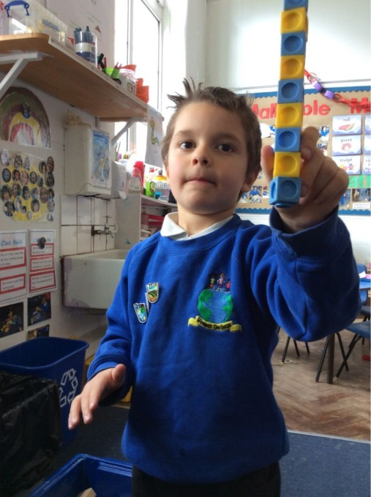
Your child’s start to Wessex Gardens

Slide 8
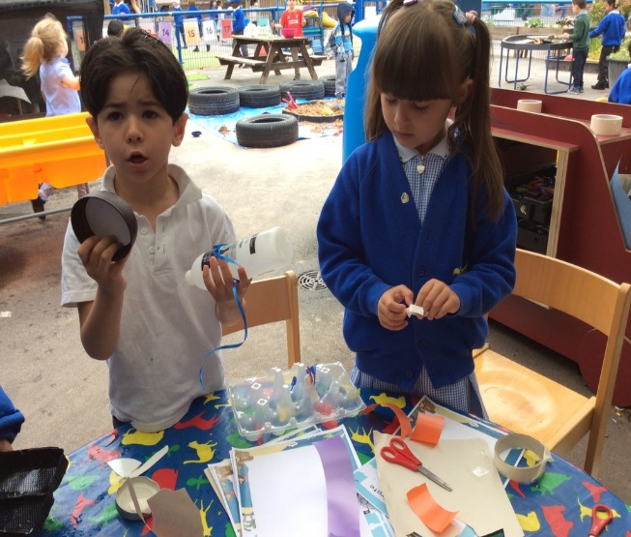
Settling in
This will be a gradual process. Even if your child has been in Nursery full time, we find this is the best method, because they are settling into a new environment with new adults.
We will come to do a home visit in September if you are new to the school. If your child is in our Nursery, we will organise times for you to come and visit your new teacher to discuss the year ahead.
The classes will be split into groups. The first group will come to school on Monday 9th September.
The other groups will come in over the following days. We will take the needs of the children into account when grouping them.
Please ask for more details from the staff if you need to.

Slide 9
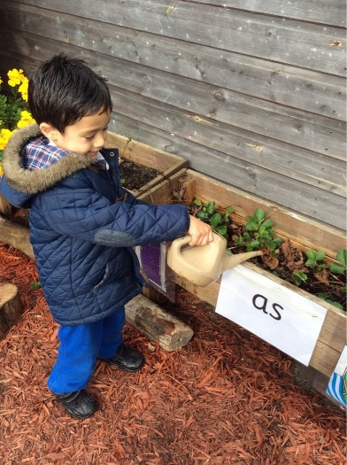
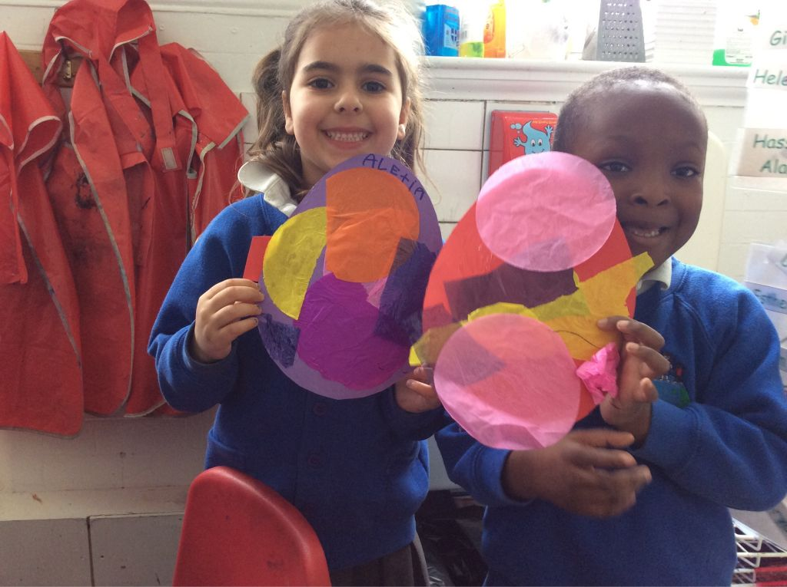
The first week
Within the next 2 weeks you will receive a letter detailing your child’s start date.
Each day a new group of children will join the class until by Friday all the children will have started.
During the first week, all the children will go home at 11.45am.
During the second week, all the children will stay for lunch and go home at 1.20pm.
During the third week, all the children will stay until 2.30pm.
After this, all the children will be full time.
We hope this will help the children to settle well which is essential to their well being and progress.

Slide 10
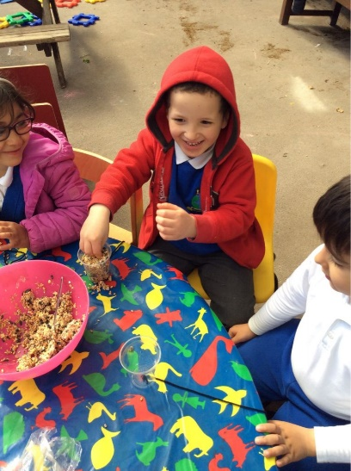
Once your child is settled:
Please be prompt at the beginning and end of the sessions.
Children can become upset if they are left waiting.
Your children will be encouraged to go outside, so please make sure they are dressed appropriately. It is essential that they have wellie boots to wear when it is wet outside!
There will be access to fruit, milk and water everyday.
We encourage you to provide a refillable water bottle.

Slide 11
What to do if your child is absent
We monitor absence very closely.
Please call us if your child is unwell.
You will almost certainly not be granted any leave of absence during term times.
Punctuality is important! Please be on time in the morning so your child does not miss out on phonics teaching.

Slide 12
What we do to meet your child’s medical needs
Allergies/Medical Conditions: please inform us if your child has or develops a medical condition. We will take details and support the child at school.
We are a ‘nut free’ school!
Illness/Minor Injuries in School: these are recorded and you will be notified of any injuries to the head.
Medication: you must inform us if your child needs any medication. If it needs to be administered in school we will ask you to complete a form.

Slide 13
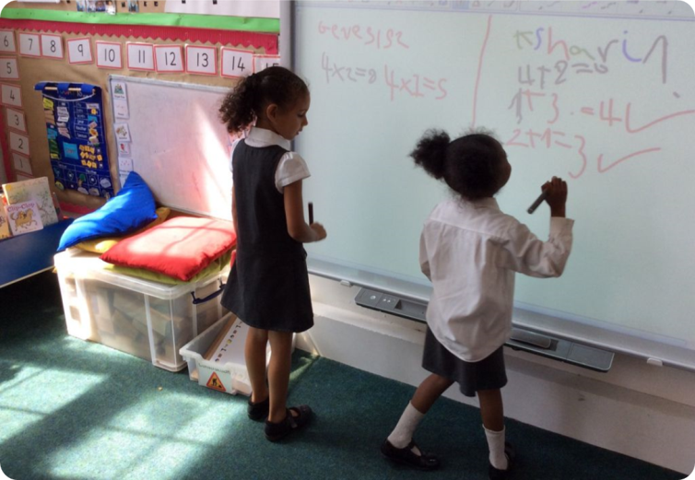
A quick guide to your child’s learning
  Your child will follow the Early Years’ Foundation Stage Curriculum.
  This is statutory and is divided into 7 areas of learning and development:
  The Prime areas:
  Communication and language
  Physical development
  Personal, social and emotional development
  Specific areas:
  Literacy
  Mathematics
  Understanding the world
  Expressive arts and design
  The curriculum is play based, child initiated, allowing for children to develop at their own rate.

Slide 14
Our routine
In the mornings, we have a ‘soft’ start to the day. This means you can come into the class at 8.40 and help to settle your child at an activity.
We have activities to improve the children’s fine motor skills, which means strengthening their arm and finger muscles for reading and writing. Please try to be here early so they can take full advantage of this!
We will have a phonics session at 9am. Reception children begin to learn to read and write, so this is a crucial time.
After phonics, the children can access independent learning, with resources and activities provided to stimulate and extend children's learning.
During the day, children to participate in activities to support their learning.
At the end of the morning, we will have another whole class session. Lunch is at 11.45.
In the afternoon, we have a whole class session at the beginning and end, including maths.
Home time is at 3.30pm.

Slide 15

Swimming
After the children have settled, usually after the Autumn half term, we will begin swimming lessons.
The children will change themselves with the aid of two adults. We encourage you to begin helping the children become confident in dressing themselves.
The children will be accompanied in the pool by two experienced swimming instructors.
They will use floats and swimming aids to support them.
One adult from the class will be with them all the time.

Slide 16
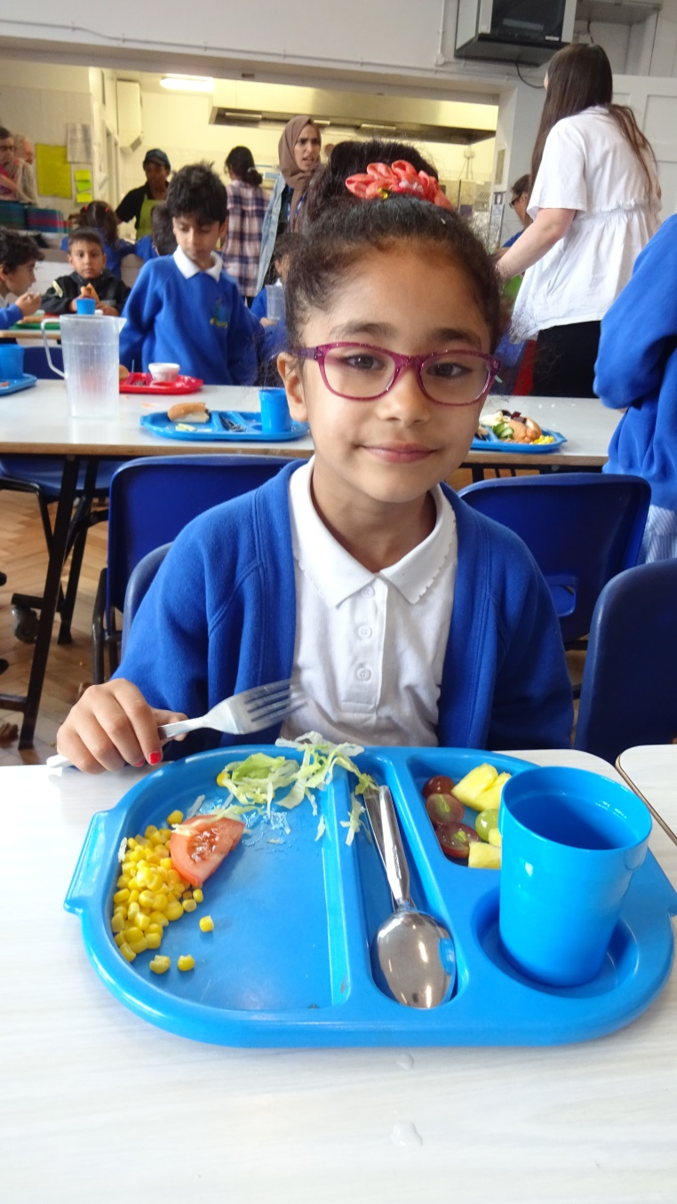
Lunch options
Lunch options: every child can have a school meal at lunchtime which is free and vegetarian & halal food is available.
You can bring a packed lunch for your child, including healthy food such as sandwiches, pasta, rice, fruit, yoghurt and cheese.
Please do not bring sweets, chocolate, nuts, crisps or fizzy drinks.

Slide 17
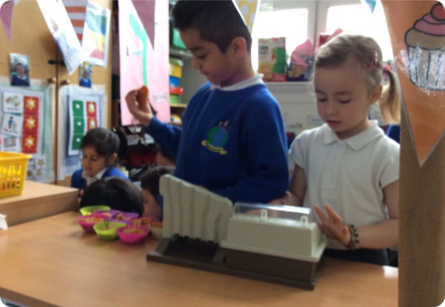
Parental involvement
It is essential that we are all involved in the children’s progress this year.
Children make lots of progress this year if given good opportunities.
We will have parents meetings in the Autumn and Spring when your child is one of our focus children.
We will also inform you about workshops through the year to help you understand and support your child in different aspects of the learning.

Slide 18
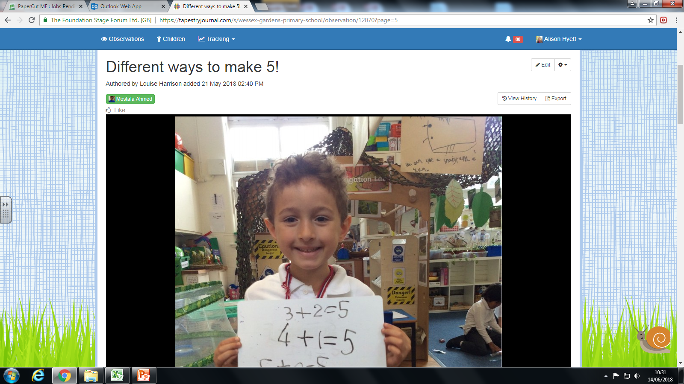
Tapestry
We also have an online learning journal – Tapestry. Using this program we make observations about your child’s learning and you have access to it. We will get your email addresses to organise your access.
It is very important that you access this every week to see how your child is learning.
You can also make upload your own photos and videos which helps us to understand your child’s skills, particularly if they are learning to speak English. This can be done on a tablet or phone.
Don’t worry we’ll teach you how!

Slide 19
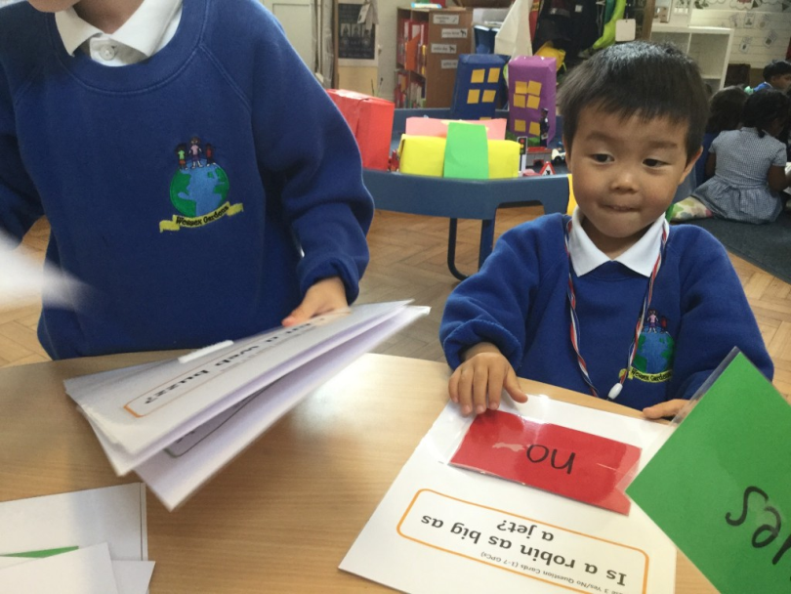

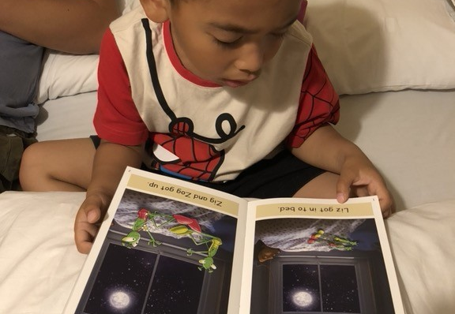
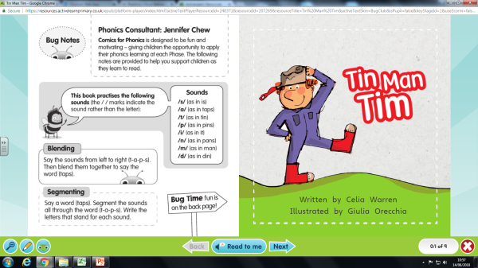
Reading
This is one of the most important aspects of your child’s learning during Reception.
We will be reading with your child several times every week, both in groups and individually.
We also have a wonderful online reading resource called Bug Club which allows your child to read decodable books on a tablet to you at home.
We recommend you do at least 10 minutes every day!
You’ll be surprised how much of a difference this makes.
The children will take home 2 books every week; one small reading scheme book for them to read to you, and one story book for you to read to them.

Slide 20
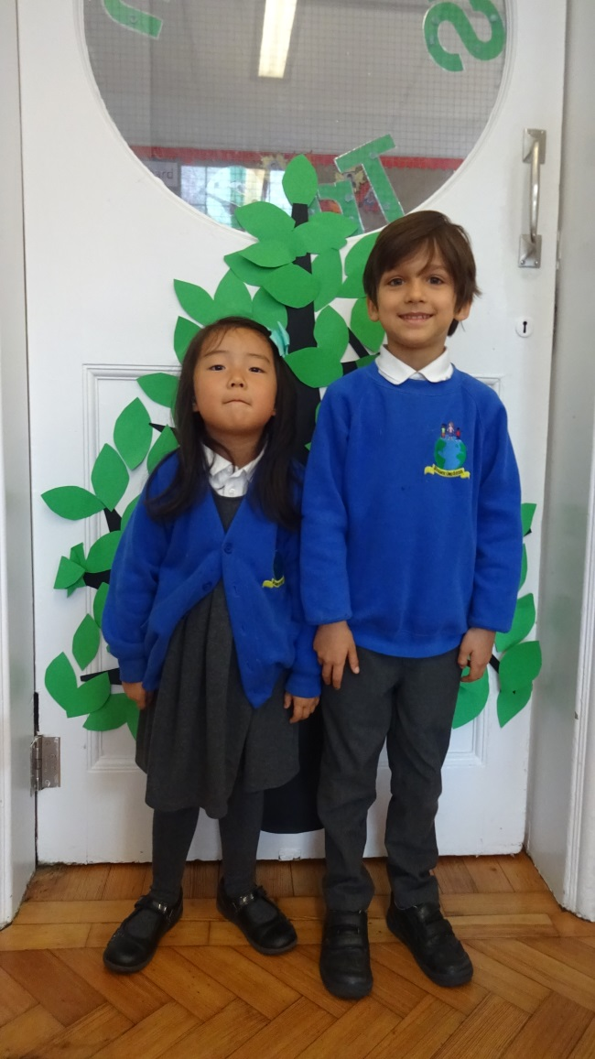
Things to bring to school:
Named book bag.
Named wellington boots.
Change of clothes in case of accidents.
Named water bottle.
All uniform and coats must have names in them.
Home learning: every child will get 2 reading books per week and some home learning every Friday. Please bring books to school every day!

Slide 21
And lastly… don’t forget to come to our open afternoon next Tuesday 25th between 2- 3pm !
This is a chance to look around the setting, and to meet the staff, and is great for the children to have that first step in getting to know their new class!

